Slide 1

A.I
Part 4 - assignment
Ihssan Aljada – 18210011
Computer Information Science
4/2/2022

Slide 2
Problem
We have sign language pictures that are unclassified and unlabeled that are needed to worked on and managed

Slide 3
Aim and Goals
Group up all the pictures of sign language
Classify the pictures of sign language
Label the groups
Give output picture based on the number input

Slide 4
methods used
Used hidden layers to split the data for processing
Used epochs to set the number of trials to train the data and increase accuracy

Slide 5
Performance measurements & improvement
Using graph to see the relation between loss and accuracy
Accuracy for all the classification, the higher the better
Classification for each digit
Adding more pictures can increase the accuracy
Increase the number of trials can increase the accuracy

Slide 6
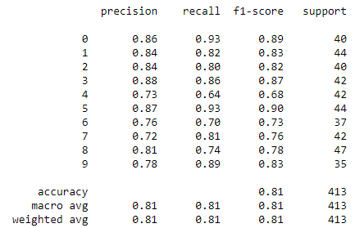
Digit classifications
The accuracy percentage may or may not change due to the fixed number of pictures that are in the dataset
The number 5 has the highest classification number
The lowest number is 4
Difference between picture can be a huge factor in the accuracy of the number, and some pixels that are very similar that can decrease of accuracy of guessing the number

Slide 7
Conclusion
With the graph that I came up with show that the accuracy of the project is getting better and better for each time I run the program or increase the number of test trails. And I say that it passes to the next stage in model development

Slide 8
Future work & obstacle
Main issue that I got, handling 3d data and I need 2D data to do the tests. I had converted the argument array to use 2D array
For future work, we can use different data sets with better quality such as using higher pixels range.
Increase the number test trail (epochs) can help increase the accuracy
Use more layers can also increase the accuracy

